Slide 1
Software Development and Debug
Zynq
Vivado 2015.2 Version

Slide 2
Objectives
After completing this module, you will be able to:
Describe device drivers architecture
Distinguish between Level-1 and Level-2 device drivers
List types of processor timers
Understand CPU’s private timer API
Describe GNU Debugger (GDB) functionality
Describe Xilinx Microprocessor Debugger (XMD) functionality
Describe Eclipse Target Communications Framework

Slide 3
Outline
Timers and API
Debugging Tools
Debug in SDK
Summary

Slide 4
Timers: Cortex-A9 Processor
Timers are an important part of an embedded system
CPU Private Timer and Watchdog Timer
Global timer (GTC)
Two 16-bit triple timer counter (TTC)
System watchdog timer (SWDT)

Slide 5
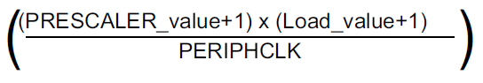
Private Timer
The private timer and watchdog blocks have the following features:
a 32-bit counter that generates an interrupt when it reaches zero
an eight-bit prescaler value to qualify the clock period
configurable single-shot or auto-reload modes
configurable starting values for the counter
the clock for these blocks is PERIPHCLK.
The timer interval is calculated using the following equation:
This equation can be used to calculate the period between two events generated by a timer or watchdog.

Slide 6
Registers Control Private Timer
The private timer is controlled via four registers :
Private Timer Load Register – used in auto reload mode. This register contains the value to be reloaded into the Private Timer Counter Register when auto reload is enabled.
Private Timer Counter Register – This register is the actual counter itself. When the value in this register reaches zero, an interrupt event flag is set (when enabled).
Private Timer Control Register – This control register enables or disables the timer, auto reload mode, and interrupt generation. It also contains the timer pre-scaler.
Private Timer Interrupt Status Register – This register contains the Private timer interrupt status event flag

Slide 7
Private Timer/Counter (Standalone)
By default 32-bit count down timer, driver in xscutimer.h, xscutimer_hw.h header files
XScuTimer_LookupConfig() - Looks up the device configuration based on the unique device ID
XScuTimer_CfgInitialize() - Initialize a specific XTtcPs instance such that the driver is ready to use
XScuTimer_Start() – Start the timer
XScuTimer_Stop() – Stop the timer
XScuTimer_EnableAutoReload() – Load the counter with the initial value when time out occurs
XScuTimer_IsExpired() – Check if the timer has reached the final value
XScuTimer_LoadTimer() – Load the timer with the provided value
XScuTimer_ClearInterruptStatus() – Clear source of interrupt flag

Slide 8
Private Timer/Counter (Standalone) – Xscutimer.h
Xscutimer.h contains functions (macros) that:
Initialize the timer
Run a timer self test
Start and stop the timer
Manage the timer (restart, check if expired, load the timer, enable/disable auto loading)
Set the pre-scaler
Get the pre-scaler value
Setup, enable, disable, clear, and manage timer interrupts

Slide 9
Debugging
Debugging is an integral part of embedded systems development
The debugging process is defined as testing, stabilizing, localizing, and correcting errors
Two methods of debugging:
Hardware debugging via a logic probe, logic analyzer, in-circuit emulator, or background debugger
Software debugging via a debugging instrument
A software debugging instrument is source code that is added to the program for the purpose of debugging
Debugging types:
Functional debugging
Performance debugging

Slide 10
Software Debugging Support
Vivado/SDK supports software debugging through
GDB tools
Unified graphical interface for debugging and verifying processing systems
Xilinx Microprocessor Debugger (XMD)
Runs all the hardware debugging tools and communicates with the hardware
Shell for hardware communication
Tool command language (Tcl) syntax and command interpreter
GNU tools communicate with the hardware through XMD
Xilinx System Debugger, Eclipse Target Communications Framework (TCF)
Notes:
GDB is a powerful yet flexible tool that provides a unified interface for debugging and verifying MicroBlaze and PowerPC systems during various development phases.

Slide 11
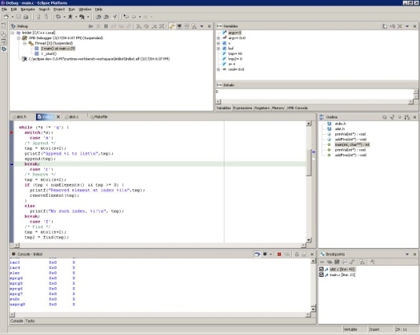
Debugging Using SDK (XMD)
Eclipse
Auto-Launched
gdb (host software)
Debugging Remote Protocol
Xilinx Custom Graphical Debug Interface
XMD
Auto-Launched
JTAG/XMD Protocol
Notes:
SDK debugging using GDB/XMD:
Seamless debugging in the Debug Perspective
Built-in XMD and GDB launchers
Integrated XMD console, direct access for non-GDB supported XMD features

Slide 12
XMD Debugger
The Xilinx Microprocessor Debug (XMD) utility provides a variety of user debug services
Physical connection between your workstation and the software design
Connection to an internal BSCAN(boundary scan) controller (JTAG controller)
Program download
Processor identification and control
Low-level debug commands
Interface to the GNU debugger
General Tcl interface and command interpreter

Slide 13
XMD Functionality
XMD engine
Program that facilitates a unified GDB interface
Tcl interface and command interpreter
XMD supports application debugging on different targets
GDB can connect to XMD on the same computer or on a remote computer on the Internet

Slide 14
XMD Commands
There are many XMD commands
Popular commands for boot and program control
connect – connect to processor
dow – download ELF executable file
elf_verify – verify ELF file with memory image
run – begin program execution from reset
con – continue program execution from current program counter
stop – stop the target processor
exit – close XMD window
XMD will search for a processor when started and launched from the SDK Run > Debug menu
connect command will execute automatically
connect arm 64

Slide 15
Debug Functionality
Source-level debugger (GDB/System Debugger)
Start your program
Set breakpoints (make your program stop on specified conditions)
Examine what has happened, when your program encounters breakpoints
Registers
Memory
Stack
Variables
Expressions
Change things in your program so that you can experiment with correcting the effects of one bug and go on to another
You can debug programs written in C and C++

Slide 16
References
Cortex-A9-MPCore-TRM.pdf

